Slide 1
Improving Price Formation in PJM
Adam Keech
Executive Director – Market Operations
Energy Policy Roundtable in the PJM Footprint
September 27, 2017, 2017

Slide 2
Why Now?
Low prices are not the problem
They do increase attention and scrutiny on the method.
The industry is changing rapidly. Markets may need to adapt to produce the right incentives.
Significant industry focus
FERC
Price Formation Docket
Chairman comments
DOE Report

Slide 3
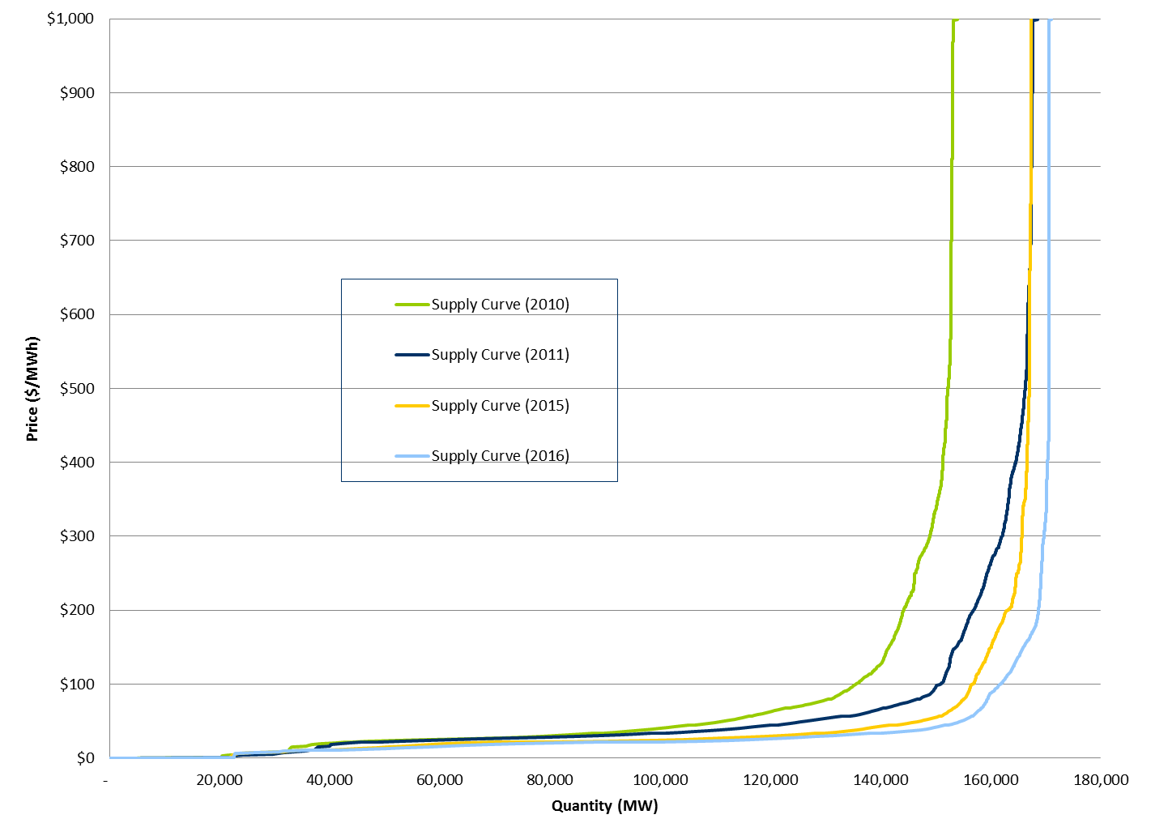
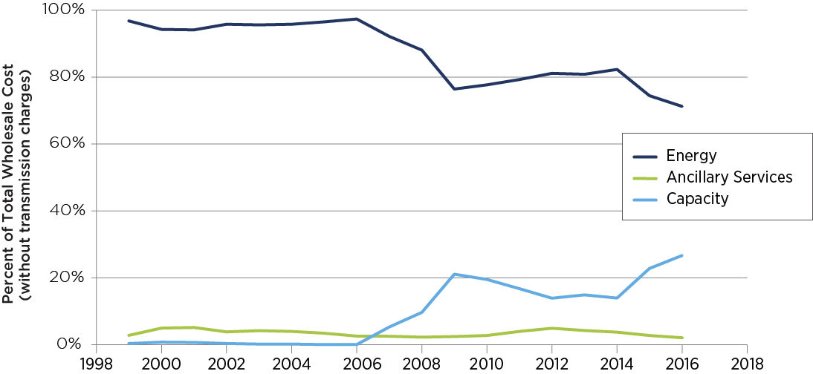
Empirical Data
Average Supply Curve 2010-2016
Generator Compensation Distribution
2016 Peak Load

Slide 4
PJM Concerns
Flattening supply curve erodes energy revenues
Capacity market revenue dependency increases
Incentive to drive down marginal cost of production is weakened due to low energy market revenues
Incentives to follow dispatch are weakened
Incentive to reduce capital costs becomes a primary incentive
Future investment based on capital costs not operating costs
The energy market is far more efficient at revenue distribution
More transparent
Rewards those that provide energy
Current Trend

Slide 5
Price Formation - Areas of Focus
General Method
Products
Environmental Attributes
Shortage Pricing
Eligibility

Slide 6
PJM Initiatives
Simulations
Testing the impacts of price-setting eligibility
Load following analysis
Operational analysis reviewing need for load following incentives
Price Formation Workpaper 2.0
More comprehensive report reviewing energy market incentives and price formation

